Slide 1
Secure Network Design and Implementation
CSCE 5585
Son Dang, Prakriti Dhungel

Slide 2
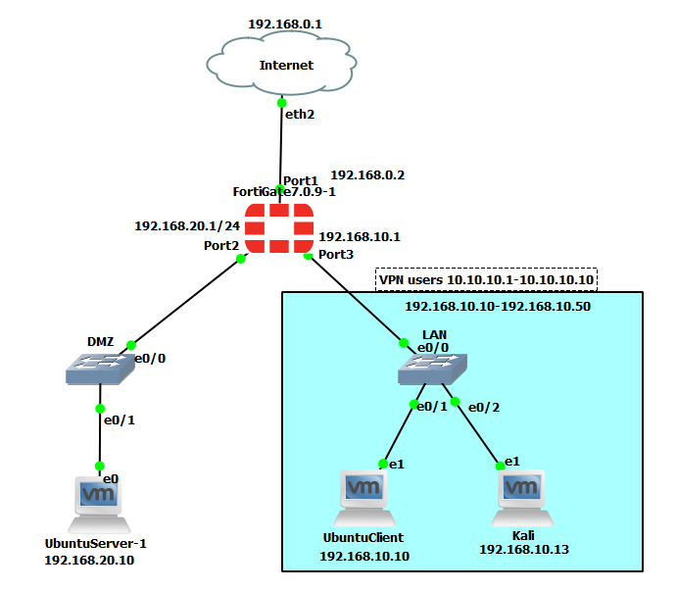
Network Environment
GNS3
FortiGate Firewall
DMZ switch
Lan switch
Servers and clients

Slide 3

Fortigate Firewall
Version 7.0.9
Allowed traffic from LAN to DMZ, LAN to internet, DMZ to internet
Block traffic from DMZ to LAN since DMZ is a public facing server
VPN and IPS functionality

Slide 4
VPN remote access
IP tunneling as part of the Firewall
Remote access for users outside the network
Users connect to private LAN network receive IP address range from 10.10.10.1 - 10.10.10.10

Slide 5
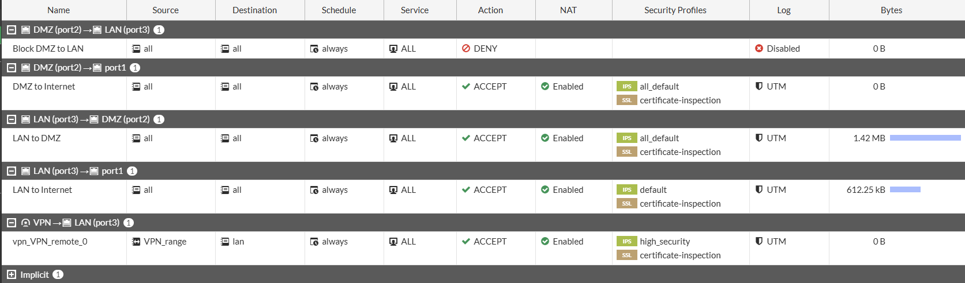
IDS/IPS configuration
Part of the FortiGate firewall functionality

Slide 6
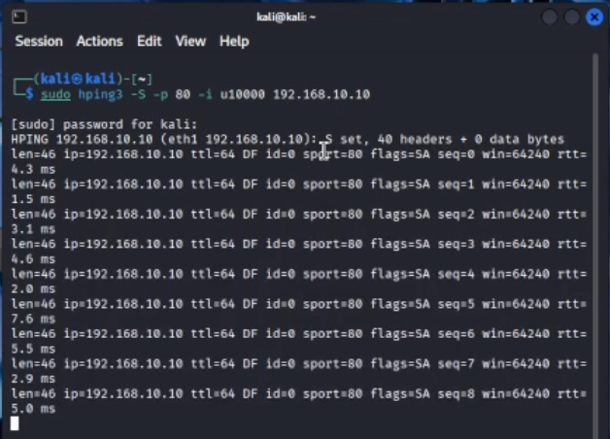
IDS/IPS (continued)
Additionally, we install Wireshark and Suricata on ubuntu client
Simulate a SYN attack using hping3 from Kali -> Ubuntu client

Slide 7
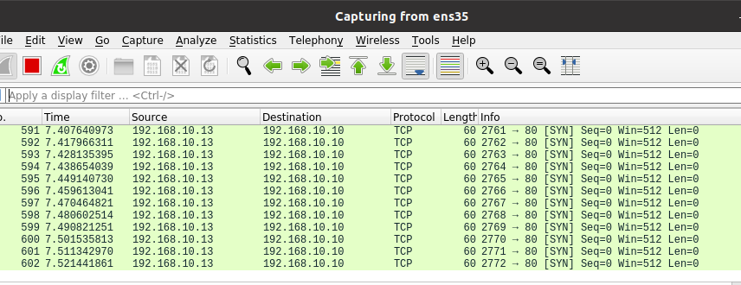
IDS/IPS(continued)
Detect using Wireshark

Slide 8
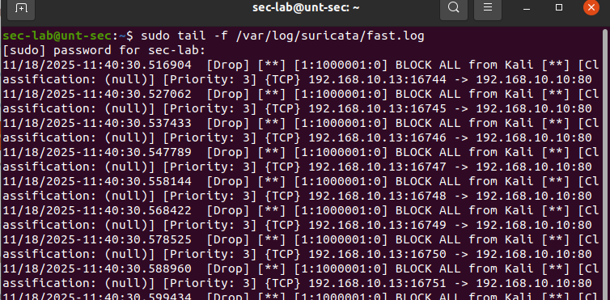
IDS/IPS(continued)
Prevent the attack using Suricata

Slide 9
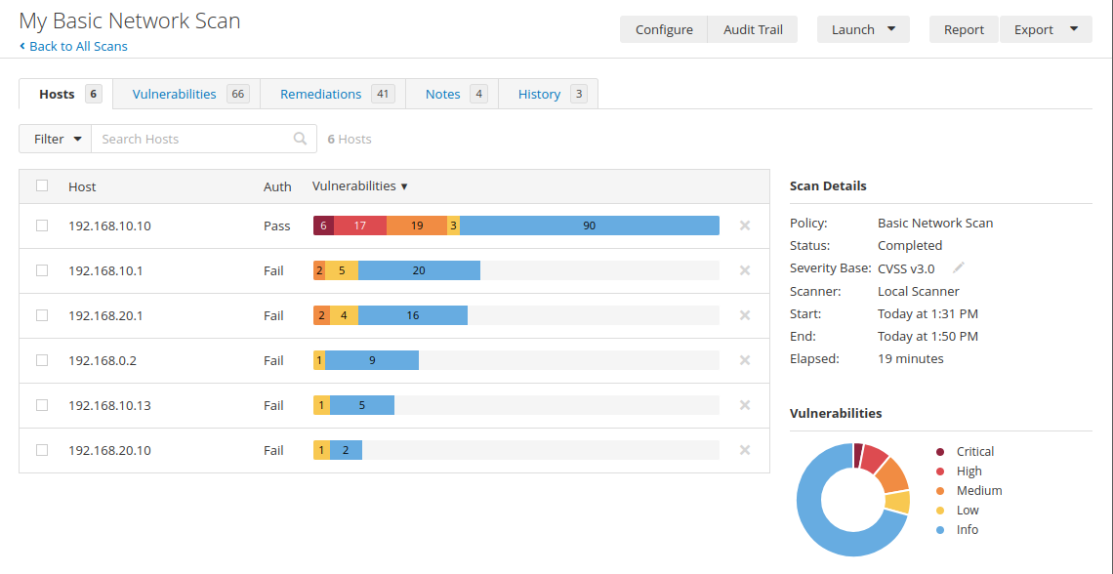
Testing and security assessment
Majority of the Critical/High/Medium are from Ubuntu local security as a result of EOL device and out of date packages from Ubuntu Client
For the network vulnerabilities: SSH weak algorithms and ICMP timestamp request which can allow attacker to map the network

Slide 10
Mitigation Strategies
For ICMP, filter ICMP timestamp requests and outgoing timestamp replies
Change the SSH Algorithms via FortiGate CLI
Update the packages in Ubuntu local machines

Slide 11
References
https://nvd.nist.gov/vuln/detail/CVE-1999-0524
https://nvd.nist.gov/vuln/detail/CVE-2019-0053

